Slide 1
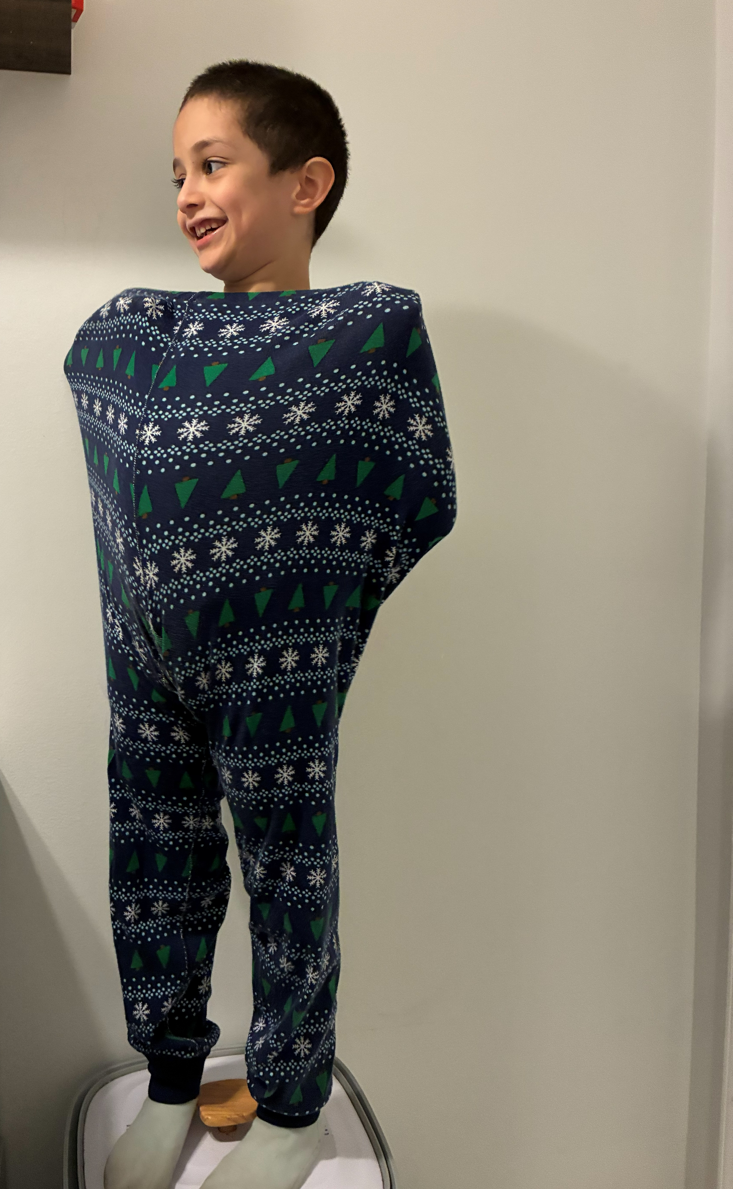

Who We Do This For: Daniel

Slide 2
DANIEL LEZAMA
Private Therapies:
7 Speech Language Pathologists
4 Occupational Therapists
Autism Diagnosis
ADHD Diagnosis
05/24/2024
04/24/2025
Montessori Teacher Online Guidance
PA EARLY inTERVENTION
LearNING CENTER
PA EARLY inTERVENTION
LIU 12* (3-21 Services)
TRELLIS ABA – Forest Hill
9/24/2021
5/16/2022 – 08/30/2024
10/03/2022 – 02/02/2023
04/26/2023-07/02/2024
09/02/2024-08/31/2026
First evaluation
Determination:
Denied eligibility for services; communication skills were determined to be within the expected age range, despite speaking fewer than 10 words.
Action: Enrolled in a private early learning program with neurotypical children on pediatrician’s recommendation to increase peer exposure and facilitate language development.
Outcome: Experienced a regression in communication skills, ultimately reducing functional speech down to a single word for expressing needs.
Second evaluation
Determination: Found eligible and accepted for Speech-Language Pathology (SLP) services.
Progress: Added Occupational Therapy (OT) services to the care plan in November 2022 following an SLP recommendation.
Third evaluation
Determination: Transferred to a new program due to age eligibility and re-accepted for SLP services.
Adjustments: SLP sessions reduced (30 to 15 min) due to attention needs; special education support added.
HCPS Kindergarten waiver for 2025-2026
Outcome: Demonstrates outstanding progress, advancing from non-verbal to a 2.0–3.5 year language level.
Key Factors: Thrives in structured environments with dedicated 1-on-1 support.
Dyanavel XR ADHD medication added to treatment plan
*Lincoln Intermediary Unit 12 – PA’s services for persons aged 3-21

Slide 3
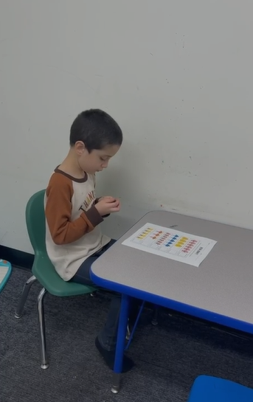
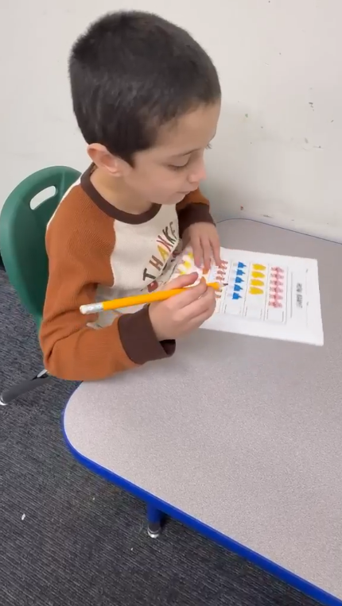
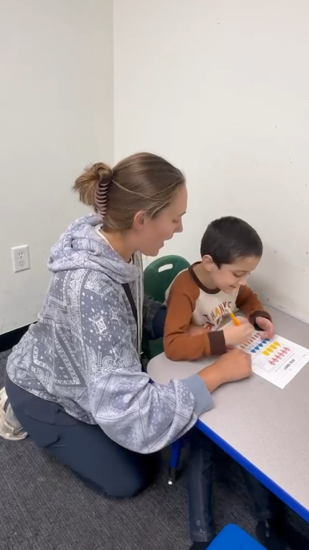
DANIEL LEZAMA
Harford County Public Schools Special Education Services: Occupational Therapy Sensory Assessment
Behaviors Which Establish the Existence of a Disability: “Daniel has most exposure in an ABA therapy clinic with more of a one-to-one adult structure. He is less likely to engage in groups. He has sensory differences and intolerance to engage in things that are non-preferred or when it interferes with what he is engaged in. Daniel himself likes to sing, and his sound level can get high. This may be his way of drowning out other stimuli and finding comfort in his own sounds. He has sensory differences that impact his ability to engage in learning.”
School Factors: “Given Daniel’s differences in his response to the sensory information in his school environment, Daniel has a Much More than Other score in School Factor 1, 3, 4, and A More than Others score in School Factor 2 . He needs more external supports to participate in learning, he has less awareness and tolerance in the learning environment, and he can be less available or learning in the school environment. He needs a very structured routine.”
Without Behavior Technician Guidance
With Behavior Technician Guidance

Slide 4
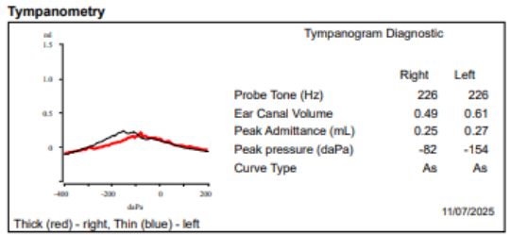
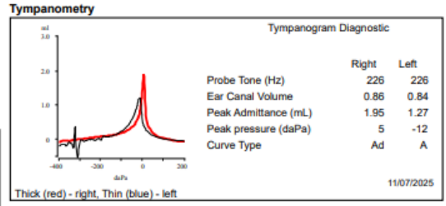
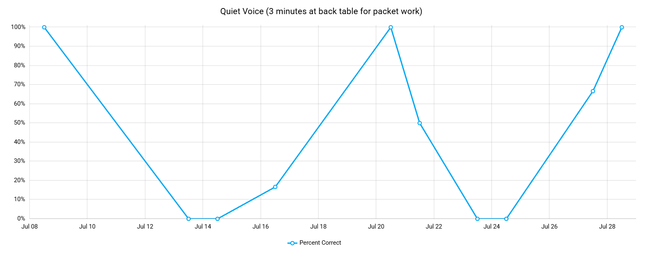
DANIEL LEZAMA AUDITORY SENSORY PROFILE
Comparison of Daniel’s results with his sister’s (November 2025):
Comparison of Daniel’s results with his sister’s:
Violette Lezama’s Results Daniel Lezama’s Results
Notes: 1. Scale in graph in the Y axis is different for each child. 2. Ipsilateral acoustic reflexes could not be measured due to Daniel’s distress. Daniel uses his own voice (echolalia) to drown other sounds.
Listener responding is an area of strength for Daniel, but his rate of acquisition of targets requires more direct 1:1 teaching.
Strategies: During group instruction, staff will use a four-token visual board featuring rule reminders and a target reinforcer picture to promote in-seat behavior and an appropriate vocal volume. Daniel earns a token accompanied by behavior-specific praise on a one-minute fixed-interval schedule, earning access to a tacklebox reinforcer after collecting four tokens.

Slide 5
DANIEL LEZAMA VISUAL SENSORY PROFILE
Last Ophthalmologist Exam: March 2026 – Normal development for his age
Visual Sensory Seeking Behaviors (Hyposensitivity)
Peripheral Visual Tracking (Looking out of the corner of his eyes): Actively seeks specific visual feedback (movement, light angles, or line alignment) using peripheral vision to process high-intensity visual input.
Linear Alignment & Organization (Item Line-Up): Engages in lining up toys or items to create structured, predictable visual order, helping him organize visual information when his environment feels overwhelming or under-stimulating.
Inspecting Fine Details Close Up: Holding objects extremely close to the face/eyes to study intricate textures, tiny printing, or small seams.
Rapid Visual Stimulation (Rapid Media Switching): When using screens or technology, he rapidly skips between short clips or fast-moving images. This indicates a desire for high-frequency visual stimulation and novelty to regulate his visual arousal level.
Visual Sensory Avoidant Behaviors (Hypersensitivity)
Bright & Flashing Light Sensitivity: Displays visual distress and avoidant responses when exposed to intense, unpredictable, or flashing light sources (e.g., dense traffic lights during nighttime holiday travel, major light shows like Hershey’s Christmas Light Show).
Impact on Self-Regulation: When visual stimuli reach peak intensity, his system experiences overload, leading to distress, avoidance, or emotional escalation. In a classroom, high visual noise (busy bulletin boards, fluorescent lights) can mimic these overwhelming conditions.
Visual Reset: Actively seeks dark or low-stimulation environments (such as walking into a dimly lit nap room or attempting to turn off light switches). This behavior shows he actively attempts to reduce visual overload to reset his nervous system.

Slide 6
DANIEL LEZAMA INTEROCEPTION SENSORY PROFILE
Toileting
Clinical / ABA Setting (Trellis Center):
Spontaneous Requests: Daniel independently requests the restroom an average of 1.4 times per day.
Scheduled Protocol: If Daniel has not spontaneously requested the restroom within a 2-hour window, therapists proactively place a bathroom break onto his visual schedule and lead him to the restroom.
Staff ensures Daniel flushes the toilet, washes his hands, and leaves the restroom with his pants on
Prompting Frequency: Clinicians initiate visual/verbal prompts approximately 2.5 times per day to ensure regular voiding and avoid accidents.
Home Environment:
Initiation Needs: At home, Daniel relies heavily on external cues, requiring prompts to utilize the restroom 80% of the time.
Home Schedule: Caregivers maintain a strict interval-based schedule, prompting Daniel to attempt the restroom every 1.5 hours to prevent accidents and support routine building.
Mealtime Prompting
Attentional Impact: High distractibility leads to missed/skipped meals without direct adult prompting and oversight.
Behavioral Triggers: Hunger significantly escalates emotional dysregulation.
Behaviors linked to Hunger: Elopement, self-injury, general aggression, and peer-directed aggression.

Slide 7
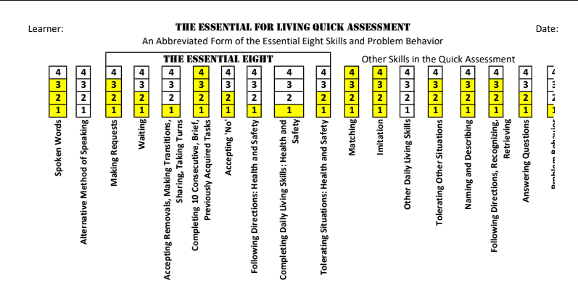
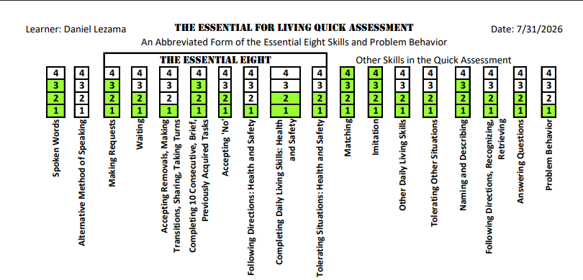
DANIEL LEZAMA Essentials for living assessment
Trellis ABA – Forest Hill: Yellow Responses
Parents: Green Responses

Slide 8
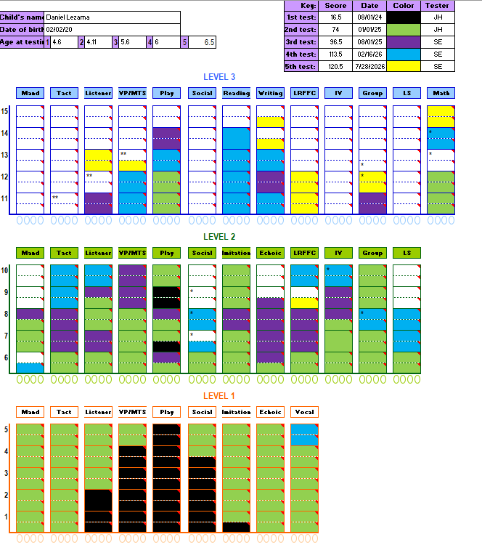
DANIEL LEZAMA VB MAPP
The VB Mapp skills breakdown:
The Level 1 is based on 0 to >18 months
The Level 2 is based 9n skills for 18 to >30 months
The Level 3 is based on skills for 30 to 48 months
Daniel has strong skills development (Level 3) in:
Reading
Writing
Math
Daniel is still developing skills (Level 2):
Social
Mand
Tact
Listening-Responding

Slide 9
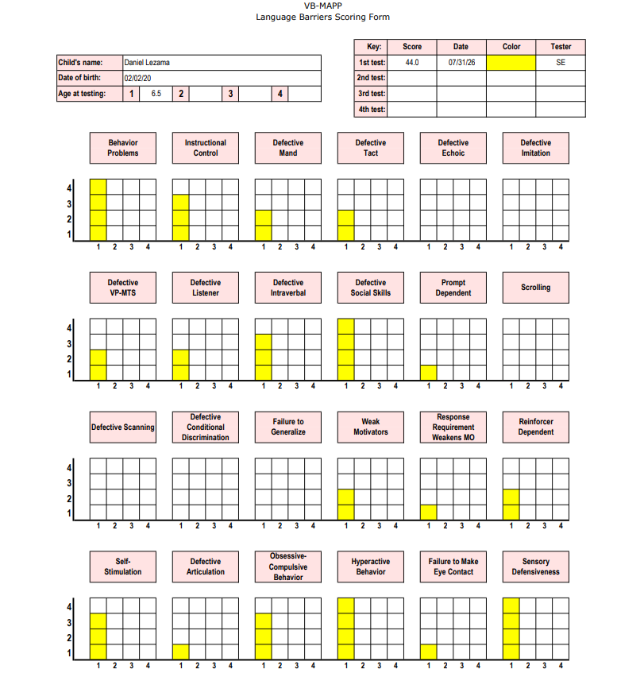
DANIEL LEZAMA VB MAPP
Language barriers
Measures barriers for skills acquisition:
Score | Rating Level | Action / Recommendation
0 | No Barrier | No intervention needed; proceed with standard programming.
1 | Mild | Monitor; manage using general classroom/clinic teaching strategies.
2 | Moderate | Implement targeted teaching adaptations and increased reinforcement.
3 | Persistent | Develop specific barrier reduction goals / formal intervention strategies.
4 | Severe | High-priority focus; conduct FBA/BIP and prioritize barrier reduction.

Slide 10
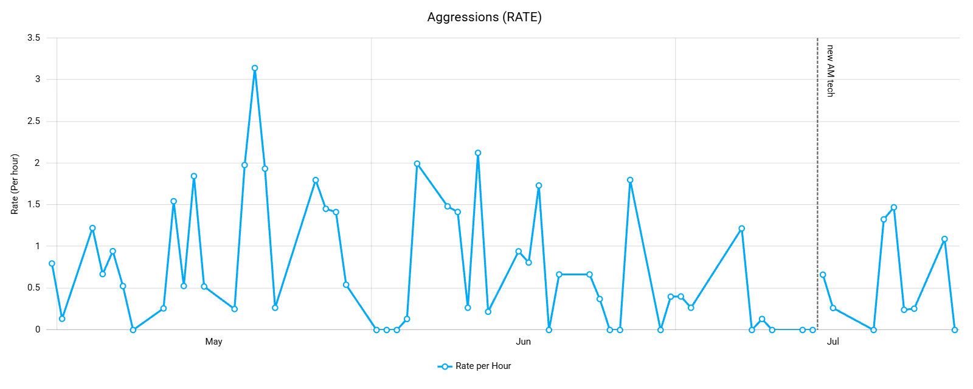
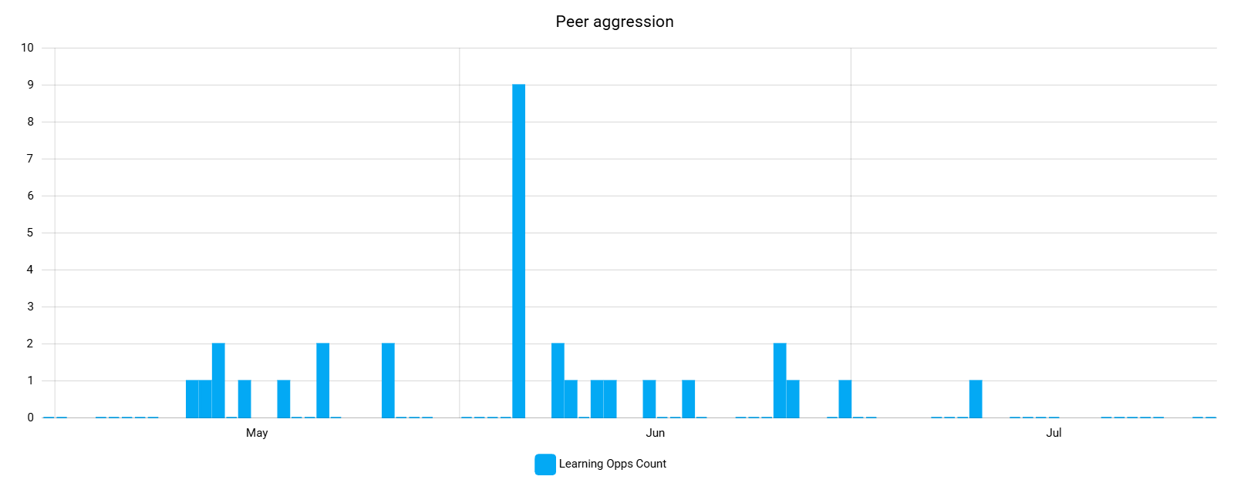
DANIEL LEZAMA AGGRESSIONS
Strategies:
Functional communication training – teach Daniel to request items and to request to end non-preferred activities using vocalizations
Choices – provide Daniel with choices throughout the day
First-then language – use first-then language when giving demands, such as first we will do your work, then we’ll draw Pixar
Visual schedule
Data/Measurement: Daniel engages in aggression at a rate of 0.74 per hour or 30 times per week. Daniel engages in peer directed aggression at a rate of 0.25 per day, or 1.25 a week.
Antecedents: Demands, denied access, low food/water intake, staff transitions, changes in routine, not wanting to share, mouthing objects. Behaviors have been noted to increase prior to bowel movements.
Replacement Behaviors: Daniel will focus on building flexibility and communication skills across daily routines. Specifically, he will practice tolerating denied access, the removal of preferred items, transitions to non-preferred tasks, and waiting periods, while staff actively model and encourage functional communication so he can vocalize his wants, needs, and requests for sensory or work breaks.

Slide 11
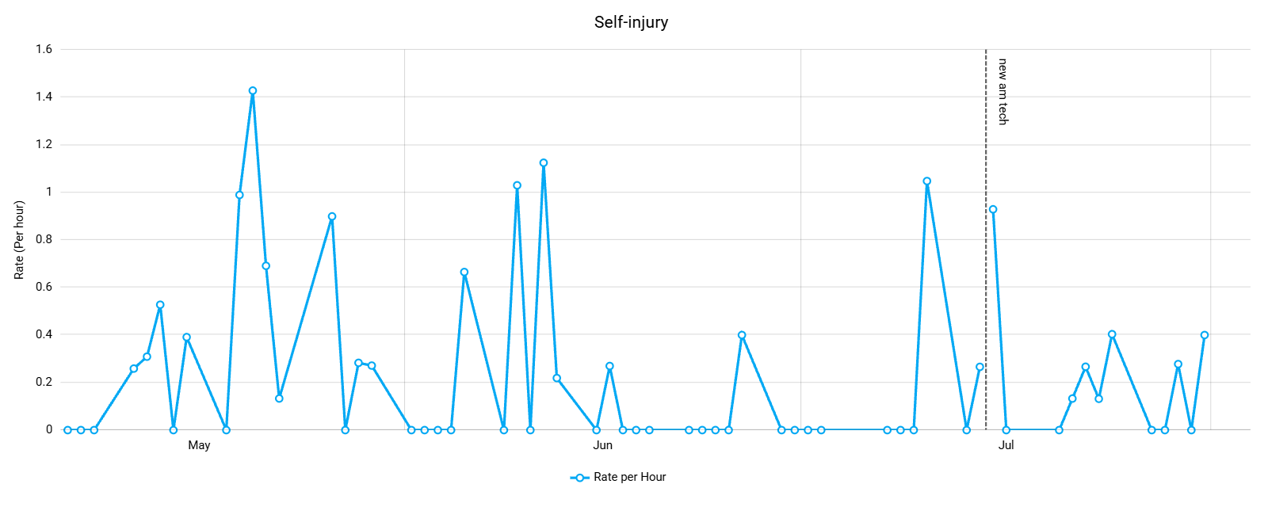
DANIEL LEZAMA self-injury behaviors
Data/Measurement: Daniel engages in self-injury an average rate of 8 times per hour across one week of ABA sessions.
Antecedents: Demands, denied access, low food/water intake, staff transitions, changes in routine. Behaviors have been noted to increase prior to bowel movements.
Replacement Behaviors: When addressing targeted behaviors, staff maintain neutral attention while physically blocking self-injury and redirecting Daniel to appropriate sensory alternatives, such as an accessible chewy tool. Additionally, staff implement Functional Communication Training (FCT) throughout the day to model, narrate, and prompt vocal requests for desired items, activities, and necessary sensory or work breaks.
Strategies:
Access function- Attempt to redirect the self-injury and prompt Daniel to use functional communication to request the item when he is calm (i.e. tolerating denied access protocol, removal of preferred items protocol)
Escape from demands function- follow through with the demand; prompt functional communication
Attention- Ignore
Response blocking: attempt to place your hand or a softer surface in between Daniel’s head and the surface he is attempting to bang on

Slide 12
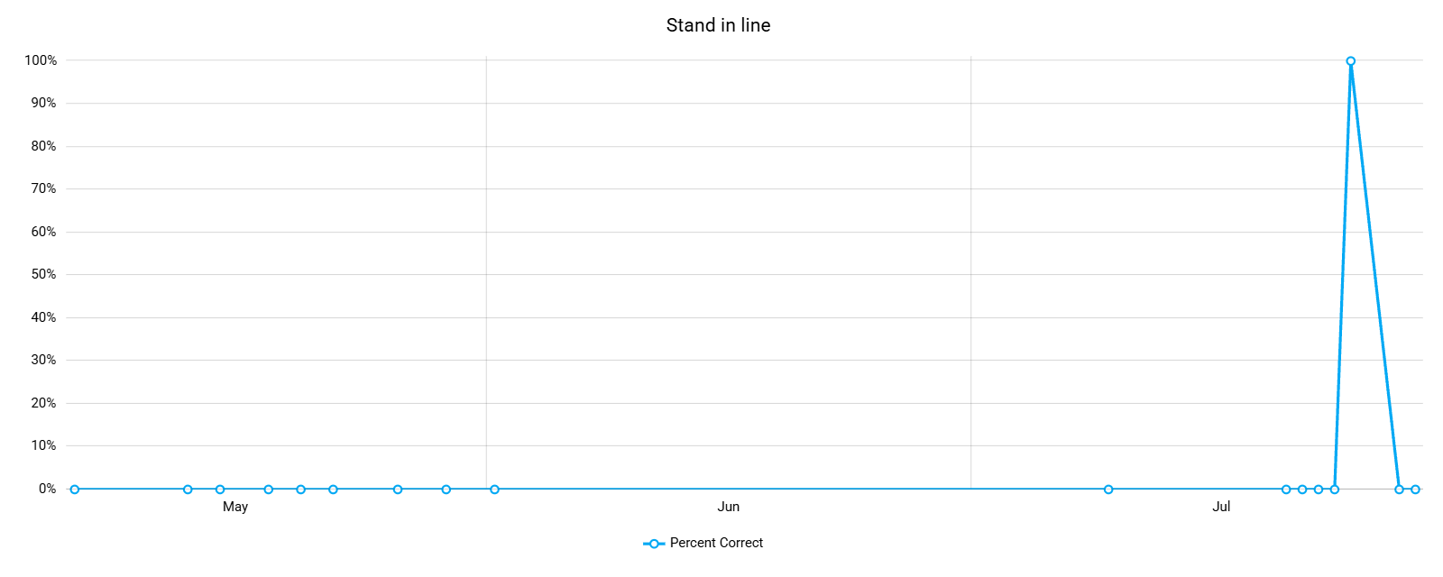
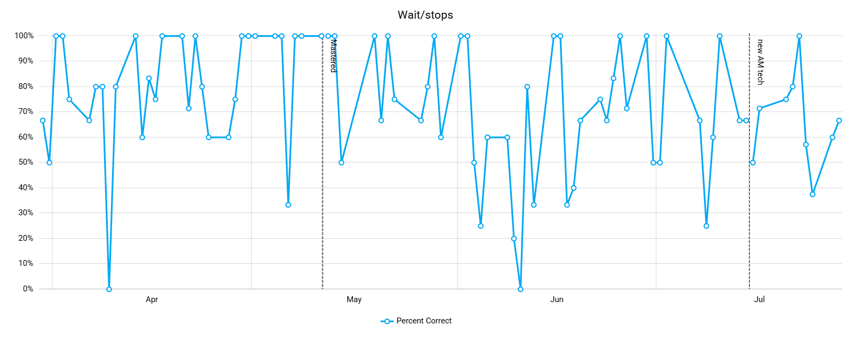
DANIEL LEZAMA FOLLOWING INSTRUCTIONS
Strategies: To support instructional compliance, hallway navigation, and safety during transitions, staff maintain continuous arm-length proximity, proactive body positioning, and forearm support in high-risk areas to ensure Daniel stops, waits, and remains with the group. Transitions are supported through pre-transition priming, visual schedules, structured line-standing routines (such as "catch a bubble"), and environmental modifications, including a two-door buffer to external exits to manage stimulus control and maintain safety.
Antecedents: Demands, denied access, low attention, staff transitions, changes in routine, not wanting to be onsite, desired tangible items/activities in other locations, extended periods of sitting
Replacement Behaviors: Daniel will practice following verbal directives to stop and wait before leaving designated areas, which supports safe line-standing, waiting in line, and transition routines. These stop-and-wait expectations are directly taught when he is calm and ready to learn, while staff actively model and encourage functional vocalizations so he can independently request sensory breaks or desired items instead of walking away.

Slide 13
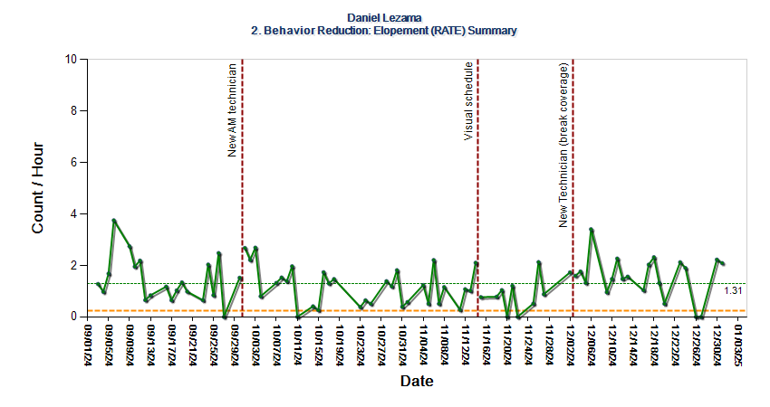
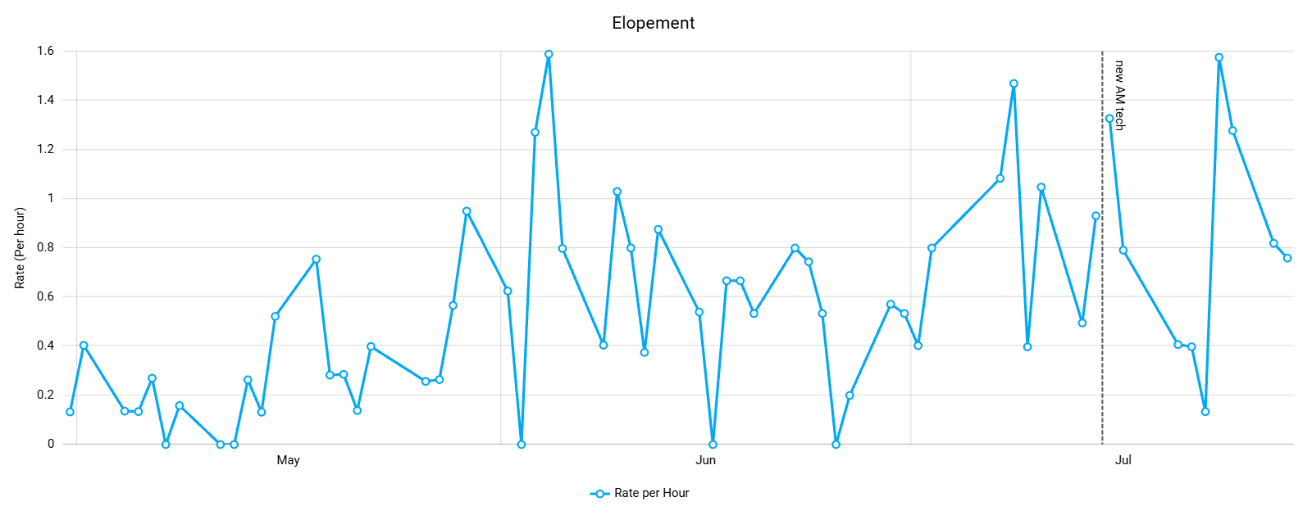
DANIEL LEZAMA ELOPEMENT/BOLTING
Strategies:
Safety and Elopement Prevention: Continuous arm-length proximity, proactive body positioning, forearm holds during high-risk transitions, and a two-door buffer to external exits.
Structure and Transitions: Visual schedules, pre-transition priming for expectations, and structured transition routines.
Visual Token System: One-minute fixed-interval schedule targeting in-seat behavior and appropriate vocal volume, trading four tokens for a selected reinforcer.
Proactive Communication and Autonomy: First/Then instructional phrasing, embedded daily choice-making, and vocal Functional Communication Training (FCT) for breaks and requests.
Data/Measurement: September 2024: Daniel engages in elopement at an average rate of 2.09 times per hour.
July 2026: Daniel engages in elopement at an average rate of 0.54 times per hour.
Antecedents: low attention, demands, transitions, desired tangible items/activities in other locations, extended periods of sitting, new staff, denied access, changes in routine, opportunity to elope

Slide 14
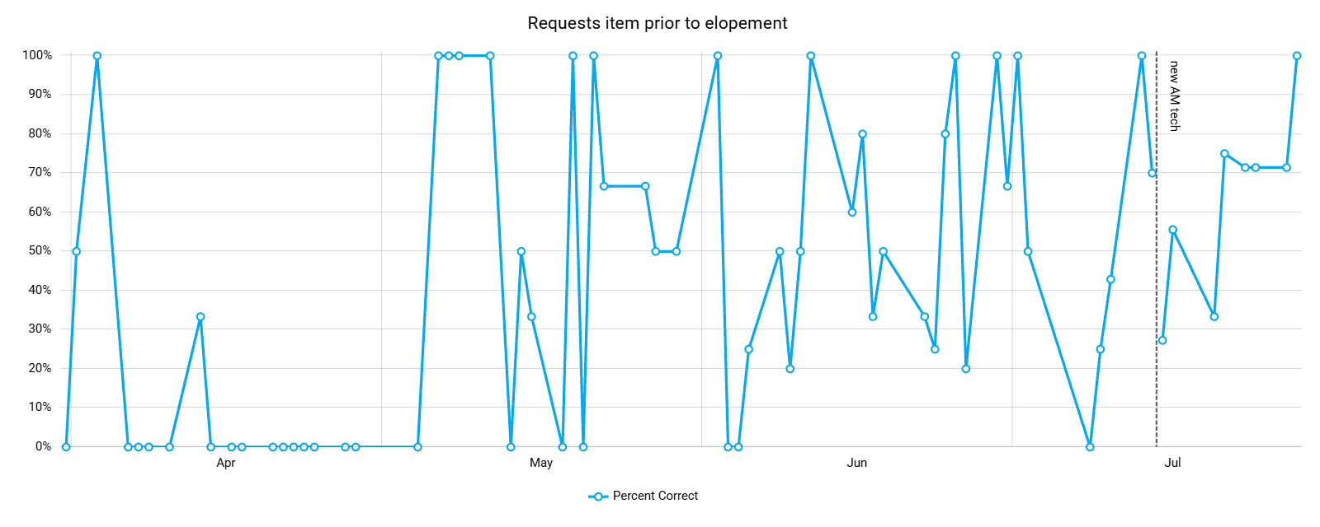
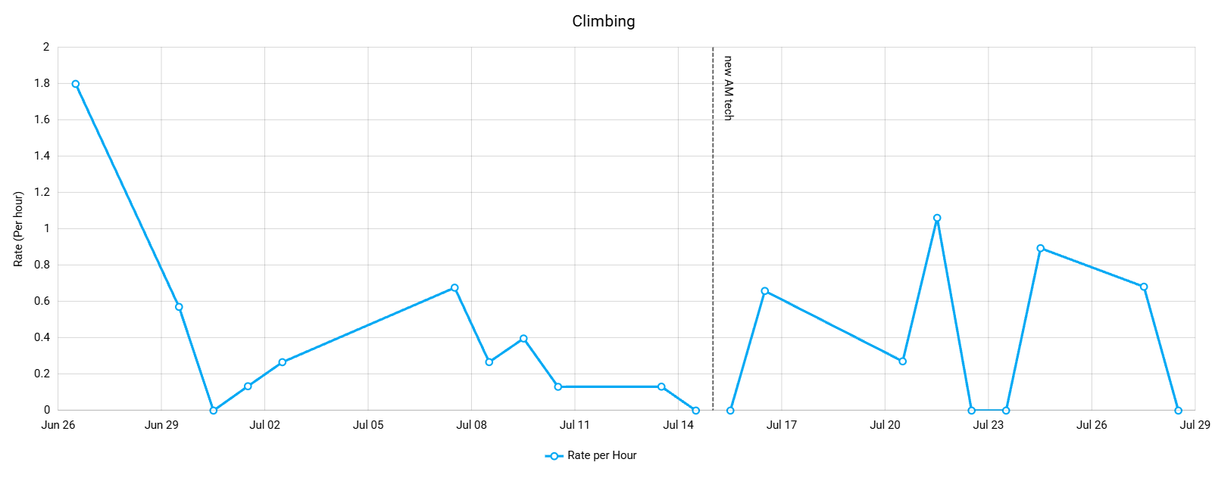
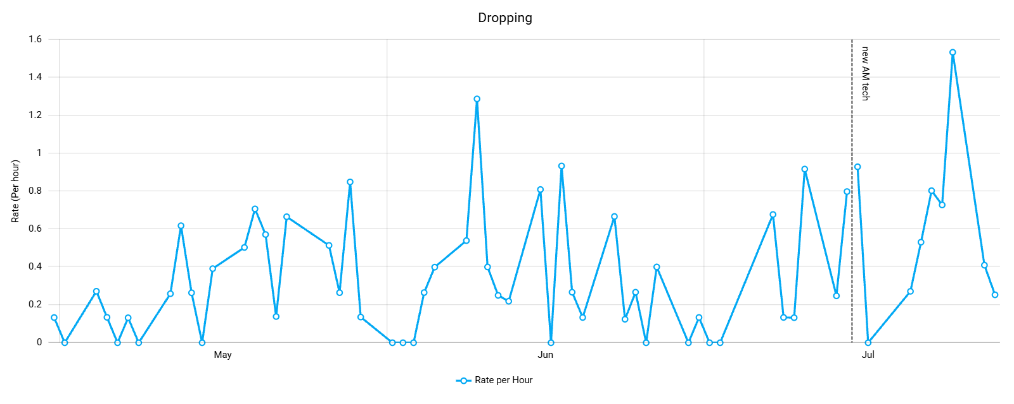
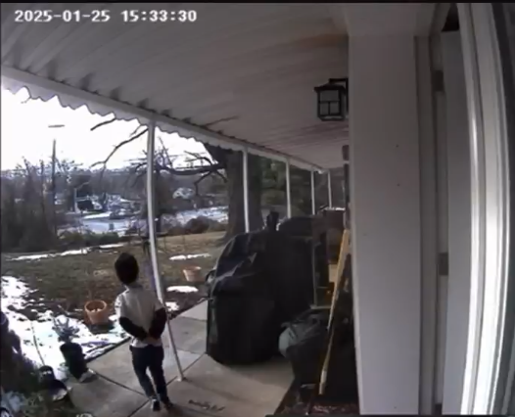
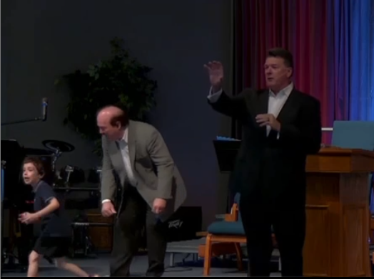
DANIEL LEZAMA ELOPEMENT/BOLTING/DROPPING/CLIMBING
Replacement Behaviors:
Daniel will learn to tolerate restricted access to preferred items, transitions to non-preferred activities, and periods of waiting, as well as respond to verbal directions to wait or stop before leaving designated areas. Additionally, staff will actively teach, model, and encourage Daniel to use functional communication.
Elopement Incidents:

Slide 15
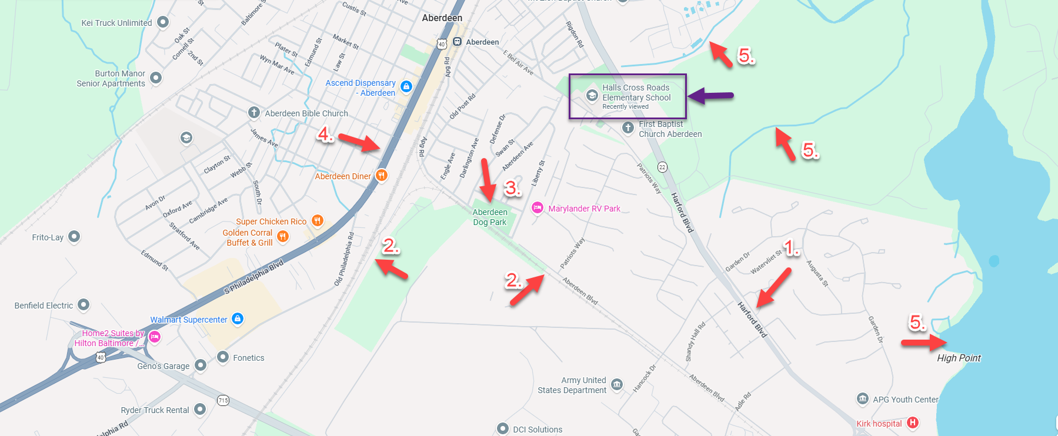
ELOPEMENT – security risks AROUND hxes
Aberdeen Thruway
Train tracks and station
Dog park
Pulaski Highway
Water sources around

Slide 16
ELEMENTS TO INCLUDE IN IEP
Behavioral and Environmental Accommodations
Non-Contingent Breaks: Scheduled/sensory breaks based on overstimulation, not tied to performance or earned compliance.
Flexible Seating: Dynamic seating options to support movement needs throughout the day.
Oral Motor Supports: Inclusion of a vibrating chewy to address mouthing as a primary self-soothing/regulation mechanism.
Sensory Breaks: Ensure that he is able to access a separate area to regulate before he goes into full sensory meltdown.
Sensory Impact on Environment: Management strategies for loud vocalizations/singing, recognizing their impact on peer learning.
Targeted Support and Program Integration
Behavior Intervention: Integration of the Trellis ABA Behavior Plan, specifically addressing problematic and self-injurious behaviors (hand/knee biting, head banging, self-slapping).
Functional Life Skills Focus: Prioritization of independent eating and toileting routines within daily goals.
Behavior Assessment: Functional Behavior Assessment (FBA) prior to or upon placement in a school setting.
Home-School Communication: Supplementary aid requiring a daily communication log (parent-provided template available if there is not an established template).

